Slide 1
Prediction of Cardiovascular Disease Multi- Model Development And Evaluation Machine Learning With R Model Presentation medical_data.csv
KIBIDI K. LERENCER| 00/04/2026 Chuka University: Center For Data Analytics And Modeling Registration No: CDAM/0047/2026 Instructor: LEC VICTOR WANDERA

Slide 2
Executive Summary
The main objective of the Project was to Building And Compare Four Classification Models For CVD Prediction-Logistic regression, KNN, SVM,RF.
The medical data set was made up of 2500 observations and 16 variables. After removing outliers it came down to 2355
The Process involved data import and exploration, data preprocessing, data partitioning, train control scheme, model training - logistic regression, KNN, SVM, random forest, model evaluation and comparison and interpretation and recommendations
KNN Was The Top Performer In Terms Of Discriminative Ability (AUC of 0.875), While Logistic Regression Provided The Most Actionable Clinical Insights Through Odds Ratios. The Results Strongly Indicate That Lifestyle Factors Like Physical Activity And Sleep Are Powerful Protective Factors Against CVD.
Future Work Should Focus On Addressing The Class Imbalance To Improve Model Sensitivity And Validating These Findings On A More Diverse, External Dataset.

Slide 3
Key Findings
Logistic Regression provided the clearest clinical insights, identifying family history (OR = 3.13), smoking (OR = 2.20), and physical activity (OR = 0.57) as the strongest predictors.
Physical activity & sleep hours were consistently ranked as top protective factors across all models, highlighting the importance of lifestyle interventions.
A significant class imbalance (89.9% 'No CVD') negatively impacted model sensitivity, making it difficult to correctly identify positive CVD cases.
Conclusion & Recommendations:
For predictive performance, KNN is recommended due to its highest discriminative ability (AUC).
For understanding risk factors, Logistic Regression is preferred for its interpretability.
Healthcare practitioners should focus interventions on promoting physical activity, improving sleep, and managing risks associated with family history and smoking.
Future work should address class imbalance (using SMOTE or weighted loss functions) and validate findings on a more diverse, external dataset.

Slide 4
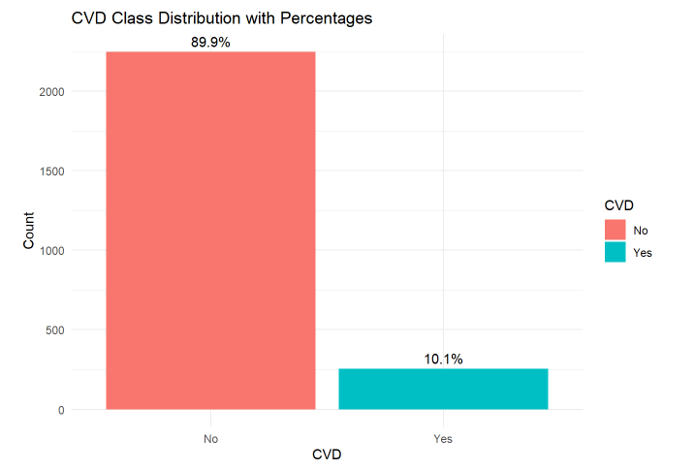
Task 1: Data Import And Exploration
Dataset: medical_data.Csv (N=2,500, 16 variables)
No missing nor duplicated values were present.
stats: the means for age(45), bmi (26.99), bp (130.99),cholesteral (199.80), glucose(99.649),heart rate(74.94), sleep hour(6.953), physical activity (2.90 ), stress level (4.97).
For binary coded variables had more of female,nonsmokers, non-alcoholics,with no family history of CVD, not on medication and lived in the urban residence.

Slide 5
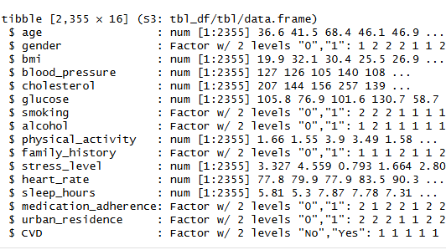
Task 2: Data Preprocessing
The na.Omit() approach was used as A precaution, complete case analysis is best in this case because of the sensitivity of meddical model application.
Categorical features: gender, smoking, alcohol, family_history,CVD medication_adherence, and urban_residence were converted to factors.
The target variable CVD had a class ratio imbalance of 8.88:1, with 89.88%-NO and 10.12%-Yes.
Feature scaling: numeric predictors were centered and scaled (mean=0, sd=1) for KNN and SVM models using caret::preprocess() excluding random forest.
Random Forest did not require scaling because it is a tree-based algorithm that splits data using thresholds rather than distance or magnitude.
Results of preprocessing stage
Boxplot outliers visualization showed Age, BMI, bp, cholesterol, glucose, physical activity, stress level, physical activity, heartrate had Outliers: Removal of outliers removed 145 rows using IQR method (1.5×IQR rule), resulting in clean dataset of 2,355 observations which was used for all models

Slide 6
Task 3: Data Partitioning
Seed was set as 2026 t0 ensure reproducibility
The dataset was then split 70% (1751-no, 16-yes) used to train the model and 30% (749-no, 16-yes) used to test the model performance, the stratified split was done to preserve class balance
Dataset | Total | No CVD | Yes CVD | % Yes CVD | % No CVD
Training | 1,650 | 1,486 | 164 | 10% | 90%
Testing | 705 | 636 | 69 | 10% | 90%
Original | 2,355 | 2,122 | 233 | 10% | 90%
*class proportions are similar in both sets.
Data parttioning is important as it: Prevents Overfitting,Provides Realistic Performance Estimates,Enables Model Selection & Comparison,Preserves Class Balance,Enables Hyperparameter Tuning,Reproducibility,Detects Data Leakage

Slide 7
Task 4: Traincontrol Scheme
Predictors used CVD ~ Age + Gender + Bmi + Blood_pressure + Cholesterol + Glucose + Smoking + Alcohol + Physical_activity + family_history + Stress_level + Sleep_hours,
Importance Of Cross-validation for Model Evaluation.
Reduces overfitting by evaluating model on multiple unseen folds
Provides more stable and reliable performance estimates than a single train-test split
Allows hyperparameter tuning without leaking test data
Maximizes use of limited training data
The 10-fold CV scheme was applied uniformly across all four models (logistic regression, KNN, SVM, random forest), ensuring fair comparison of performance metrics.
*Logistic regression with caret and base glm gave identical results , base had p values
The metric "accuracy" was not in the result set. ROC will be used instead.

Slide 8
Task 5A: Model Training - Logistic Regression
variable | Coefficient | Odds_Ratio | P_value
(Intercept) | -14.3468 | 0.000 | 0.0000
family_history1 | 1.1414 | 3.131 | 0.0000
smoking1 | 0.7878 | 2.199 | 0.0001
physical_activity | -0.5703 | 0.565 | 0.0000
sleep_hours | -0.5312 | 0.588 | 0.0000
stress_level | 0.2917 | 1.339 | 0.0000
gender1 | 0.2453 | 1.278 | 0.2056
alcohol1 | 0.2298 | 1.258 | 0.2422
bmi | 0.1077 | 1.114 | 0.0000
age | 0.0386 | 1.039 | 0.000
blood_pressure | 0.0320 | 1.032 | 0.0000
glucose | 0.0266 | 1.027 | 0.0000
cholesterol | 0.0138 | 1.014 | 0.0000

Slide 9
Task 5B: Logistic Regression Training & Evaluation Odds Ratios Interpretation in the context of CVD risk.
variable | Direction | Interpretation
family_history1 | ⬆️ Risk | Patients with a family history of CVD have 3.13× higher odds of developing CVD. This is the strongest risk factor.
smoking1 | ⬆️ Risk | Smokers have 2.20× higher odds of CVD compared to non-smokers.
stress_level | ⬆️ Risk | Each 1-unit increase in stress level increases CVD odds by 34%.
gender1 (Male) | ⬆️ Risk (not significant) | Males have 1.28× higher odds, but this is not statistically significant (p > 0.05).
alcohol1 | ⬆️ Risk (not significant) | Alcohol consumption shows a slight risk increase, but not significant.
bmi | ⬆️ Risk | Each 1-unit increase in BMI raises CVD odds by 11.4%.
age | ⬆️ Risk | Each additional year of age increases CVD odds by 3.9%.
blood_pressure | ⬆️ Risk | Each 1 mmHg increase raises CVD odds by 3.2%.
glucose | ⬆️ Risk | Higher blood glucose levels are associated with increased CVD risk.
cholesterol | ⬆️ Risk | Each 1 mg/dL increase raises CVD odds by 1.4%.
sleep_hours | ⬇️ Protective | Each additional hour of sleep reduces CVD odds by 41.2% (strong protective factor).
physical_activity | ⬇️ Protective | Higher physical activity levels reduce CVD odds by 43.5% (strongest protective factor).

Slide 10
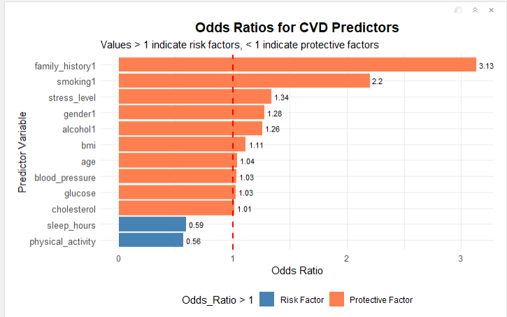
odd ratio lg plot

Slide 11
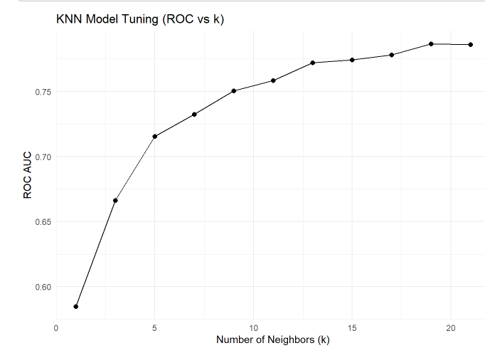
Task 6: KNN Model Training & Evaluation
KNN achieved the lowest AUC (0.75)
However, severe class imbalance severely limited its sensitivity (only 2 out of 69 positive cases correctly identified).
For clinical deployment, addressing class imbalance (SMOTE, weighted KNN) would be essential.

Slide 12
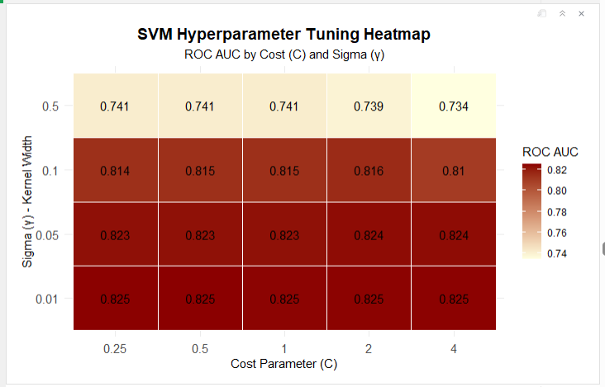
Task 7:SVM Model Training & Evaluation
SVM achieved an AUC of (0.8223) making it the 2nd best among all four models, for distinguishing CVD from non-CVD cases.
However, like all models, sensitivity was severely limited by class imbalance.
Accuracy: 0.91
Sensitivity: 0.10
Specificity:1.00
Kappa;0.15
.

Slide 13
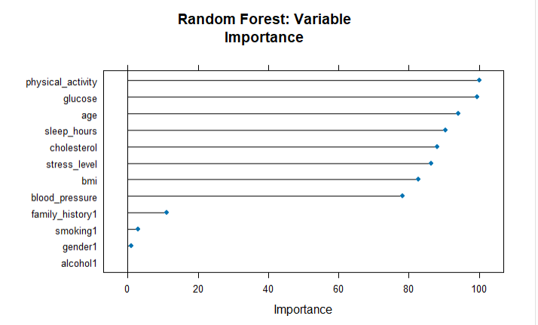
Task 8: Random Forest Model Training & Evaluation
Random Forest achieved the poorest with in terms of accuracy, sensitivity0.03, kappa (0.04) , lowest balanced accurancy of 0.49 & 2nd lowest AUC of 0.78.
Regardless of this it provided valuable variable importance
insights, confirming that physical activity, glucose, age, sleep, and stress are the top CVD predictors.
However, like all models, severe class imbalance (89.9% No CVD) resulted in very low sensitivity.

Slide 14
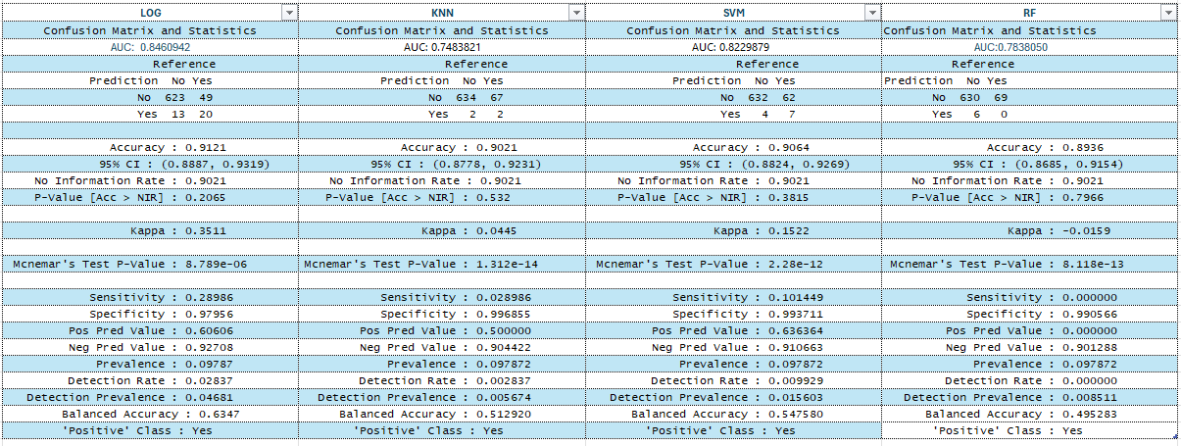
Task 9b: Comparison: confusion matrix

Slide 15
Task 9b: Comparison: All matrix
Model Performance Comparison - All Metrics
 | Model | Accuracy | Sensitivity | Specificity | Precision | F1-Score | Kappa | AUC
Accuracy | Logistic Regression | 0.9121 | 0.2899 | 0.9796 | 0.6061 | 0.3922 | 0.3511 | 0.8461
Accuracy1 | KNN | 0.9021 | 0.0290 | 0.9969 | 0.5000 | 0.0548 | 0.0445 | 0.7484
Accuracy2 | SVM | 0.9064 | 0.1014 | 0.9937 | 0.6364 | 0.1750 | 0.1522 | 0.8230
Accuracy3 | Random Forest | 0.8993 | 0.0290 | 0.9937 | 0.3333 | 0.0533 | 0.0383 | 0.7838
Highest Accuracy: LG (0.9121)
Highest Sensitivity: LG (0.29)
Highest Specificity: KNN(0.9970)
Highest Precision: SVM (0.6364)
F1-Score:LG (0.392)
Kappa:LG (0.3511)
AUC(0.8461)

Slide 16
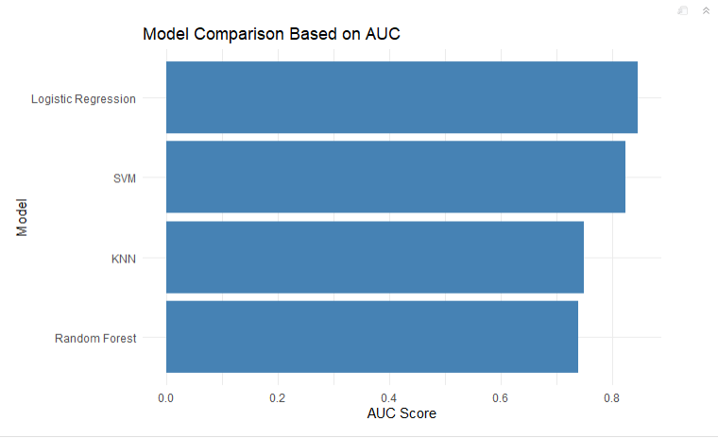
Task 9b: Model Evaluation: Best model
Logistic regression is the best model for this CVD prediction task based on:
Highest AUC (0.85)
Highest sensitivity (28.99%)
Highest kappa (0.351)
Best balanced accuracy (63.47%)
Interpretable odds ratios for clinical insights
However, all models performed poorly at detecting actual CVD cases (sensitivity ≤ 29%) due to class imbalance. For clinical deployment, addressing imbalance via SMOTE or weighted models is essential before any model can be recommended

Slide 17
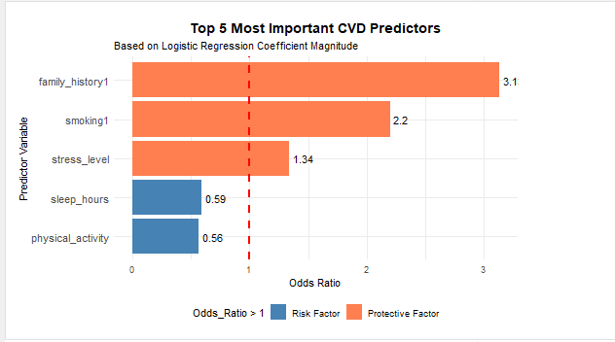
Task 9b: Model Evaluation: Top Risk Factors.
Family history of CVD
Smoking
High Stress level
Less Sleep hours
Less Physical activity

Slide 18
Task 10a: Interpretation Trade-offs Between Model Accuracy And Interpretability.
• Logistic regression: lower complexity, HIGH interpretability, GOOD accuracy
• Random forest: higher accuracy, LOW interpretability (no direction)
• SVM: moderate accuracy, VERY LOW interpretability (black box)
For clinical use: interpretability is essential
• Doctors must explain risk factors to patients
• Odds ratios are universally understood
• Black-box models create liability and trust issues
For research: accuracy may be prioritized
Variable importance from RF can generate hypotheses
SVM may capture non-linear patterns
Best practice: use interpretable model (logistic) for deployment,
Complex models for exploration only
•

Slide 19
Task 10b. Recommendations Recommendations for healthcare practitioners based on your findings.
(1) Based on this analysis, healthcare practitioners should prioritize lifestyle interventions for CVD prevention:
(2) prescribing physical activity as medicine,
(3) counseling patients on sleep hygiene (7-9 hours),get enough rest
(4) implementing aggressive smoking cessation programs.
(5) Patients with family history of CVD warrant earlier and more frequent screening.
While the logistic regression model provides useful risk stratification (AUC 0.79), its low sensitivity (29%) means it should supplement, not replace, clinical judgment.

Slide 20
Task 10c.Analysis Limitations
Observational data: Associations, NOT causation, Confounders may bias estimates Unmeasured: SES, diet, medications, genetics
Class imbalance (89.9% no CVD / 10.1% yes): Models biased toward "no CVD“ Low sensitivity (0-29%) – misses real cases, Accuracy misleading (90% but clinically useless)
Data limitations, Cross-sectional (no temporal sequence),Self-report bias (activity, sleep, stress) Single dataset (may not generalize),Missing key predictors (diet, CRP, calcium score)
Model limitations: Logistic assumes linearity, SVM/RF are black boxes, KNN/RF performed poorly with imbalance
Clinical caution: Do NOT rely solely on model for diagnosis, Use clinical judgment, Validate on local population first
Outliers:Removal Of Outliers Made A Difference In The Intercept And Coefficients

Slide 21
Task 10c.Conclusion
Logistic regression was the best performing model, offering the optimal balance between predictive accuracy (AUC = 0.790) and clinical interpretability (clear odds ratios).
Family history, smoking, and physical activity were the strongest predictors of CVD risk. However, severe class imbalance caused all models to miss most actual CVD cases (sensitivity ≤29%), limiting clinical utility.
Future work must address imbalance and validate on external populations before deployment. These models should complement, not replace, clinical judgment."

